Slide 1

Collection of SDN Telemetry Data
Idan Yadgar & Omri Huller
Supervised by Jalil Morany

Slide 2
Some background…

Slide 3
What is a software defined network?
Abstraction layer that allows a flexible network
Separates control plane from data plane – switches don’t decide how packets are forwarded
Controllers are the brain of the network – they decide the routing policy
Many protocols for control plane – for example OpenFlow

Slide 4
OpenFlow protocol
Application layer
Used to access the control plane
Flow tables
Controller decides – switches execute

Slide 5
What do we want to achieve?
While network is on-air: collect metrics dynamically
Timestamped metrics
Byte count, packet count, 5-tuple…
Distinguish between switches
Run analytics, draw conclusions

Slide 6
Main steps
Step 1: Collecting network metrics
Simulate network with mininet
Create a custom controller
Listen for commands, collect metrics dynamically
Create a CLI
Create metric-collectors
Step 2: Pushing metrics to PNDA
Our watchdog
Step 3: Writing & running analytics
Creating a Jupyter notebook

Slide 7
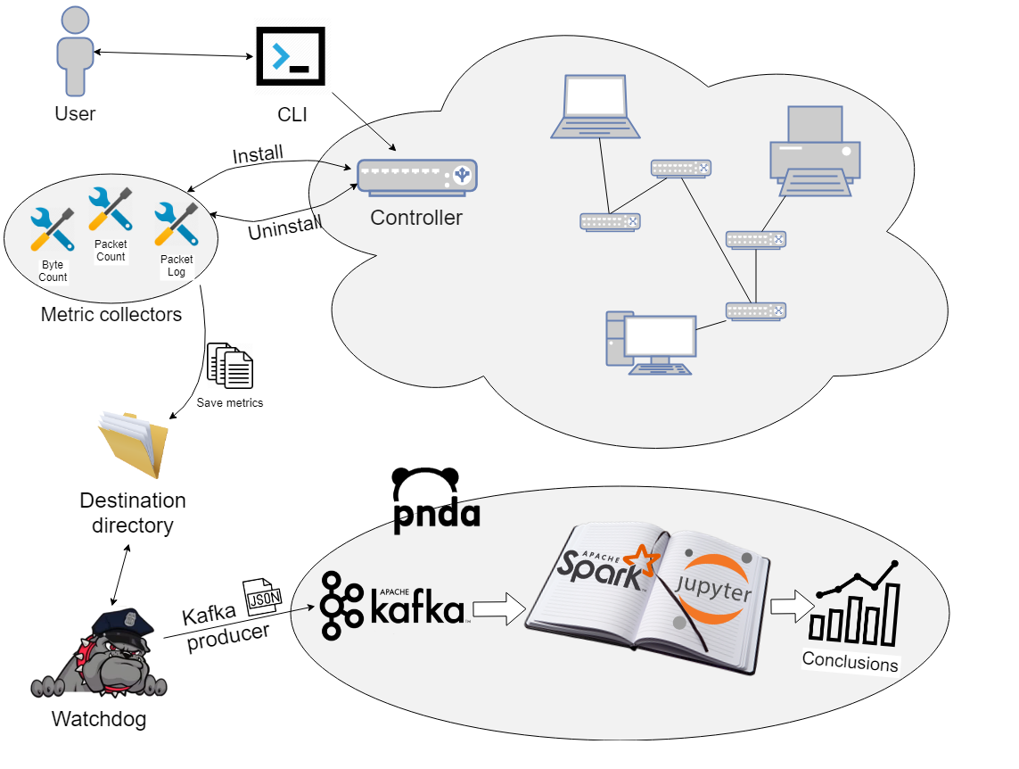
Bird’s eye view

Slide 8
Step 1: Collecting networks metrics

Slide 9
Simulating the network with mininet

Slide 10
Simulating the network with mininet
We used mininet and created an SDN
Hosts, switches and a custom remote controller

Slide 11
Create a custom controller

Slide 12
Create a custom controller
Build Ryu controller
Listen for CLI connection
Receive commands:
Install application (“metric-collectors”)
Uninstall application
Load applications which collect metrics

Slide 13
The CLI

Slide 14
The CLI
Python application
Connects to the controller
Sends install/uninstall commands
An interface for loading and unloading applications dynamically while on-air

Slide 15
The “metric-collectors”

Slide 16
The “metric-collectors”
Loaded & unloaded dynamically
Add & remove rows from the flow tables
Output metrics to destination directory

Slide 17
Step 2: Pushing metrics to PNDA

Slide 18
Our watchdog

Slide 19
Our watchdog
Watches the destination directory
Gets notified when a file is created or modified
Reads the new collected metrics and truncates the directory
Pushes the metrics to PNDA

Slide 20
What is PNDA?

Slide 21


What is PNDA?
In collaboration with MEF
Platform for Network Data Analysis
A scalable big-data analytics platform for networks
Includes many software components:
Apache Kafka
Apache Spark
Jupyter
...

Slide 22
Apache Kafka

Slide 23

Apache Kafka
A distributed pub-sub streaming platform
Data is organized using topics
The entrance gate of PNDA

Slide 24
Apache Spark

Slide 25

Apache Spark
An analytic engine for large-scale data processing
Allows to analyze via many libraries:
SQL & DataFrames
MLlib (machine learning)
GraphX
…

Slide 26
The Jupyter Notebook

Slide 27

The Jupyter Notebook
Provides a web interface for creating, sharing and running documents that contain live code
Integrates with Apache Spark
Allows data exploration with pandas (such as plotting)
Comes with many data-analysis libraries out of the box

Slide 28

Red PNDA
A PNDA platform for development, demonstration and education
Smaller, simpler subset of PNDA
More lightweight and designed to run on a laptop
Includes less capabilities, but has Kafka, Spark and Jupyter
Installed on a single VM

Slide 29
Pushing data to Red PNDA
Read collected data by our watchdog
Implement a Kafka producer
Send data to “raw” topic
Data is saved in the filesystem of the Red PNDA’s VM
/data/year=2018/month=8/day=26/hour=9

Slide 30
Step 3: Writing & running analytics

Slide 31

Writing & running analytics

Slide 32
Writing & running analytics
Create a Jupyter Notebook
Read the data and manipulate using Spark
Plot using pandas library
Save notebook for future use

Slide 33
Our topology

Slide 34

Enough with the talking, Show us something real!

Slide 35
Let's sum it all together
Simulate network with mininet
Load “metric-collectors” dynamically
Read collected metrics by watchdog
Push metrics to Red PNDA using Kafka
Analyze data using Spark inside a Jupyter notebook

Slide 36
Trying to move to PNDA
Has two components
PNDA itself
PNDA CLI
We encountered building issues while trying to install PNDA
Maybe it was not designed to run on a single VM?
We decided to stay with red PNDA due to lack of time

Slide 37
What we have learned
Working with software-defined-networks
OpenFlow protocol, Ryu
Got to know many big-data tools
Apache Kafka
Apache Spark
Our first real project with python

Slide 38
Something for the community
Ryu does not have an easy way to load apps dynamically
We created a solution to install and remove apps on-the-fly
Can be utilized in many application

Slide 39
What’s next?
Use the platform on bigger topologies
Write more metric-collectors
Move to PNDA
Write more analytics

Slide 40

Any Questions?

